Slide 1
Microsoft New Original Content
Insight into successful movie trends.

Slide 2
Introduction
My name is Rusty Brown, and I am a lead data scientist on this project. And yes, I’m that nerdy type who never liked presenting in front of groups of people. I would rather stay in my den and write code all day long.

Slide 3
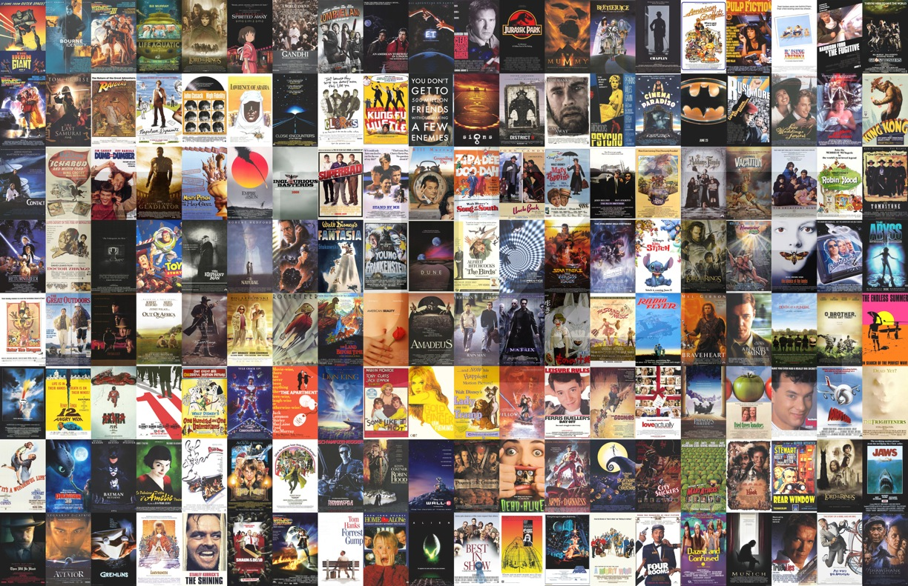
Where To Start?
Title | Release Year | Genres
Sunghursh | 2013 | Action,Crime,Drama
One Day Before the Rainy Season | 2019 | Biography,Drama
The Other Side of the Wind | 2018 | Drama
Sabse Bada Sukh | 2018 | Comedy,Drama
The Wandering Soap Opera | 2017 | Comedy,Drama,Fantasy
... | ... | ...
Kuambil Lagi Hatiku | 2019 | Drama
Rodolpho Teóphilo - O Legado de um Pioneiro | 2015 | Documentary
Dankyavar Danka | 2013 | Comedy
6 Gunn | 2017 | None
Chico Albuquerque - Revelações | 2013 | Documentary
146144 Movies
With IMDB listing nearly 150,000 movie titles, it can be hard to determine where to start.
We will will look at the top grossing movies and analyze trends to give you a better understanding of the market.

Slide 4
Our Focus
General Genre Trends
What genre trends appear in the top grossing films?
Subgenre Trends
Are some subgenres more prevalent than others?
Movie Runtime
How long are the top grossing movies?

Slide 5
Genre Trends
Top Grossing Films
$793 million average worldwide gross.
Action & Adventure genres are the most popular.
50% of the genres are Action or Adventure.

Slide 6
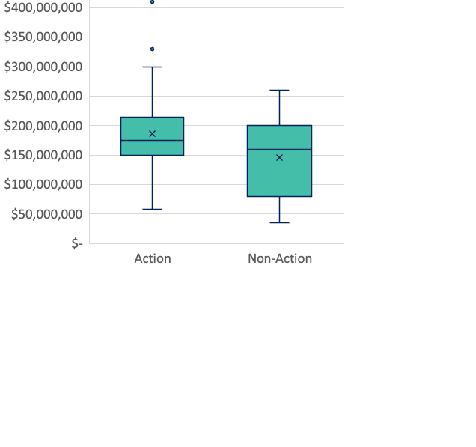
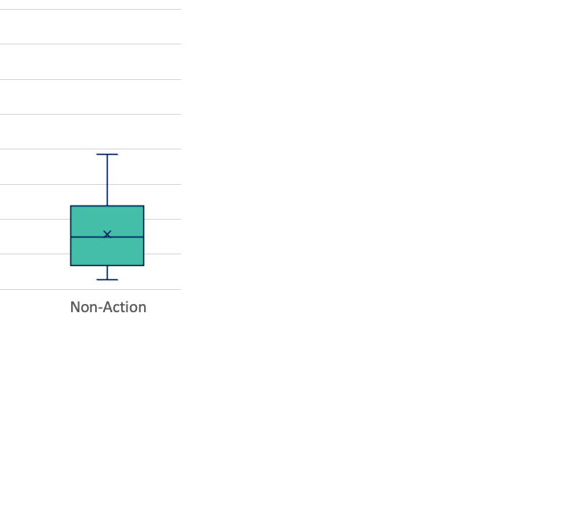
Genre Trends – Action Films
Action Films
$175 million average production budget
$902 million average worldwide gross
Non-Action Films
$160 million average production budget
$816 million average worldwide gross

Slide 7
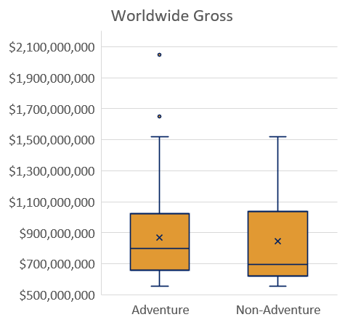
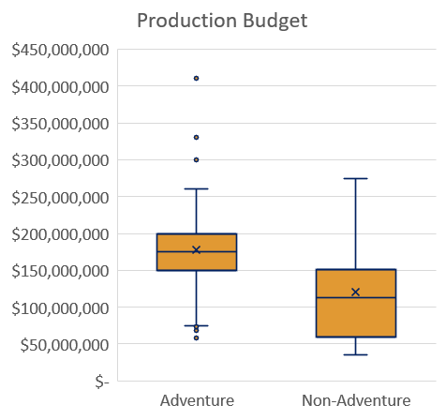
Genre Trends – Adventure Films
Adventure Films
$178 million average production budget
$870 million average worldwide gross
Non-Adventure Films
$121 million average production budget
$845 million average worldwide gross

Slide 8
Subgenre of Action & Adventure Trends
Films that are Action & Adventure average $53 million more worldwide gross than Non-Action and Adventure
Sci-Fi makes up 49% of all Action or Adventure films.

Slide 9
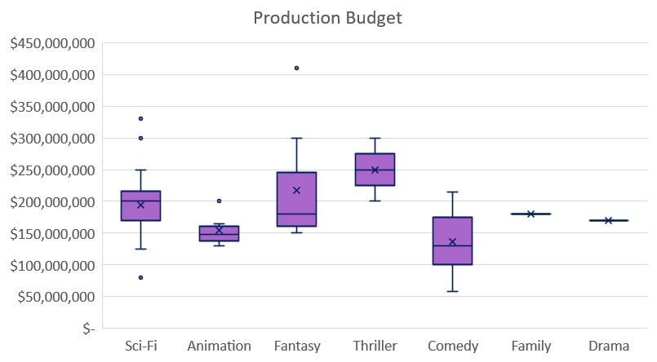
Subgenre of Action & Adventure Trends
Production Budget
Average:
$188 million
Sci-Fi:
$194 million (3.2% over average)

Slide 10
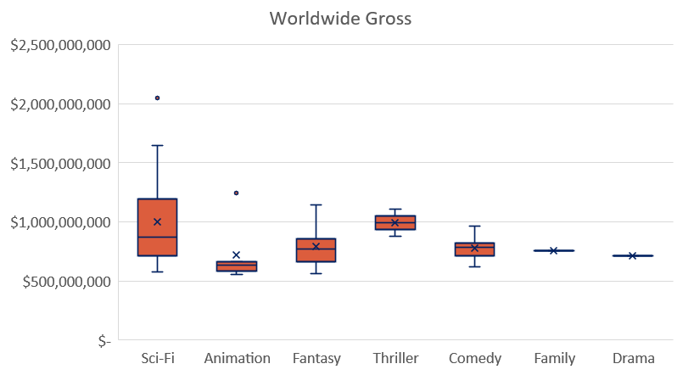
Subgenre of Action & Adventure Trends
Worldwide Gross
Average:
$892 million
Sci-Fi:
$1 billion (12.4% over average)

Slide 11
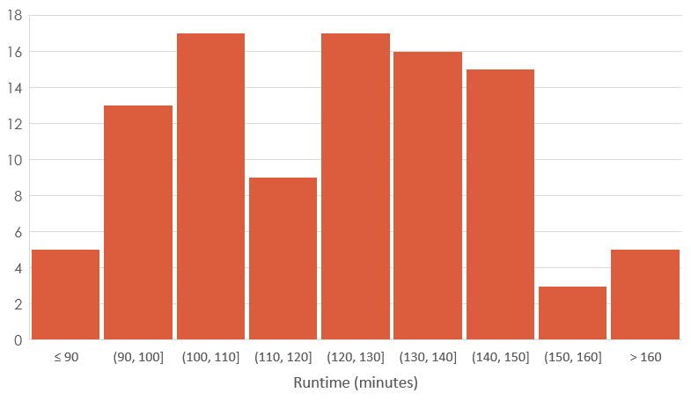
Runtime
48% of top grossing films 120-150 minutes.
Average runtime is 123 minutes.

Slide 12
Runtime
Longer movies tend to have a larger worldwide gross.
This is due to the correlation between increased budget and increased runtime.

Slide 13
Recommendations
Action or Adventure Film
Worldwide Gross:
$878 million
Return on Investment:
$700 million
Action, Adventure, Sci-fi
Worldwide Gross:
$1 billion
Return on Investment:
$809 million
Runtime
Average:
127 minutes
Worldwide Gross:
120-150 minutes
$931 million

Slide 14
Future Improvements

Slide 15

Questions?

Slide 16

Contact
Address
4508 Swingster Ln, Sachse, Texas
Contact Number
(405)207-6766
Email
jonathan.r.brown32@gmail.com

